Slide 1
Oversight of prosecutorial decision making and conduct

Slide 2
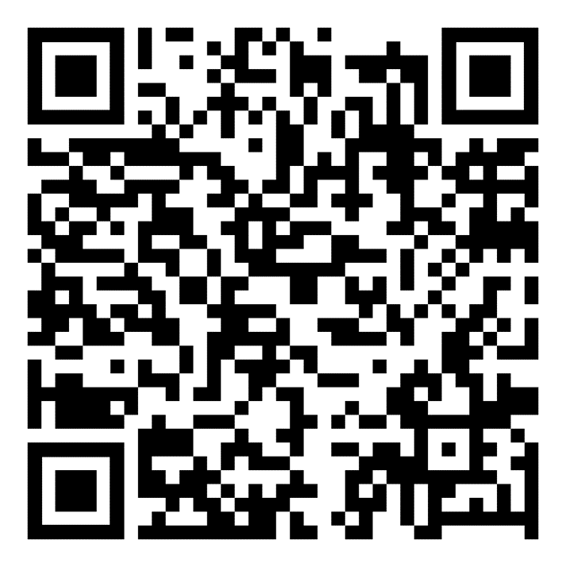
Oversight of prosecutorial decision making and conduct
Resources for conference:
https://tinyurl.com/burge2023
Q&A Join at slido.com #burge2023

Slide 3
10:00 am: Welcome Professor Courtney Anderson, Associate Dean for Academic Affairs
10:05 am: Overview
Professor Clark Cunningham, W. Lee Burge Chair in Law & Ethics, GSU College of Law, Director, National Institute for Teaching Ethics & Professionalism

Slide 4
Ahmaud Arbery February 23, 2020

Slide 5
Travis McMichael and Greg McMichael

Slide 6
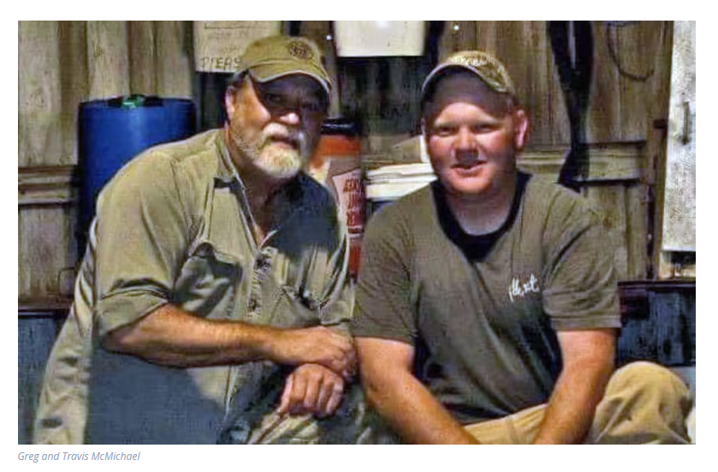
Greg McMichael and Travis McMichael

Slide 7
DA Jackie Johnson with Greg McMichael, former employee of DA’s office

Slide 8
May 6, 2020

Slide 9
May 8, 2020

Slide 10
May 12, 2020

Slide 11
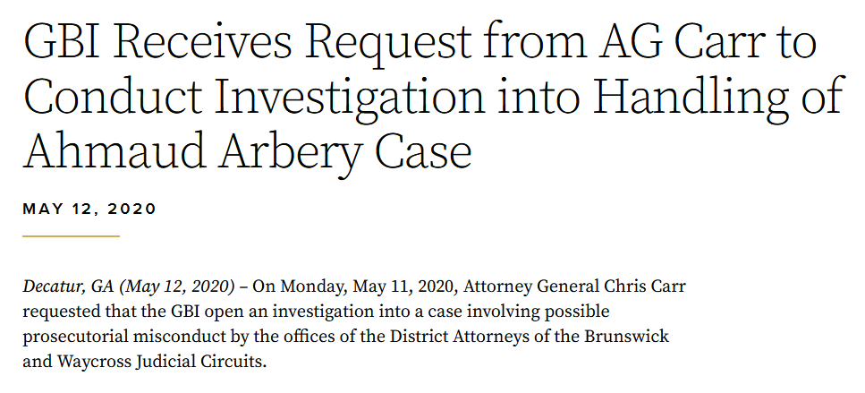

Slide 12
Fulton County DA Paul Howard April – May 2020

Slide 13
June 16, 2020
On June 16, Robert Trammell, the minority leader of the Georgia House of Representatives, introduced as part of “Justice for All” package of 12 criminal reform bills, House Bill 1214, a measure that would amend Georgia law to create a District Attorneys Oversight Commission.
This proposal would give the commission “the power to discipline, remove and cause involuntary retirement of district attorneys.” The commission would consist of 10 members—seven on an investigative panel and three on a hearing panel.

Slide 14
February 17, 2021 DA Dick Donovan
Gov. Brian Kemp on Wednesday signed an executive order suspending Paulding County District Attorney Donald Richard "Dick" Donovan.
Donovan was indicted Feb. 17 for bribery, two counts of false swearing and violating his oath of office.
Donovan is accused of committing bribery when he dismissed a criminal case in Paulding County Superior Court in which the defendant was being represented by the prosecutor of the municipal court in nearby Cedartown.
In exchange, the indictment alleged Donovan was trying to influence the prosecutor to dismiss a shoplifting case in the Cedartown court that was pending against a woman who worked in his office.
The indictment also alleges Donovan lied when he denied "ever having said that he wanted to have sex" with [that woman] and that he lied when he denied "describing his fantasies desiring to be physical" with the woman.

Slide 15
Federal grand jury investigating former DA Paul Howard March 16, 2021
A federal grand jury in Atlanta is investigating former Fulton County District Attorney Paul Howard and his use of a nonprofit to pad his salary with almost $200,000 in city of Atlanta funds

Slide 16
DA Mark Jones November 15, 2021
Georgia prosecutor pleads guilty, resigns as jury deliberates his case
Mark Jones had already been suspended as Chattahoochee Judicial Circuit district attorney after the state attorney general’s office obtained the indictment Sept. 7.
It accused him of trying to influence a police officer’s testimony, offering bribes to prosecutors in his office and trying to influence and prevent the testimony of a crime victim.

Slide 17
January 26, 2022
Former Paulding County District Attorney Dick Donovan pleaded guilty to one misdemeanor count of unprofessional conduct Thursday and was sentenced to 12 months of probation.
As part of his plea deal, Donovan, 76, has resigned as DA and must surrender his law license. Donovan, who had served as DA since 2010, was indicted in February on charges of bribery, violation of oath by public officer and two counts of false swearing.

Slide 18
September 2, 2021

Slide 19
Carr Announces Indictment of former Brunswick DA for Violation of Oath of Public Officer and Obstruction of a Law Enforcement Officer
[DA Jackie Johnson] violated her oath by showing favor and affection to Greg McMichael during the investigation into the shooting death of Ahmaud Arbery
did knowingly and willfully hinder Stephanie Oliver and Stephan Lowrey, law enforcement officers, in the lawful discharge of their official duties by directing that Travis McMichael should not be placed under arrest

Slide 20
Waycross DA George Barnhill
After the shooting of Ahmaud Arbery, [DA Johnson] sought the assistance of Waycross Judicial Circuit District Attorney George E. Barnhill
and, after disqualifying her office, recommended DA Barnhill to the Attorney General’s Office for appointment as the case prosecutor
without disclosing that [DA Johnson] had previously sought the assistance of DA Barnhill on the case

Slide 21
Prosecutorial ethics are in the spotlight after the death of Ahmaud Arbery ABA Journal
DA Barnshill’s son was an assistant district attorney working for District Attorney Johnson.
Barnhill’s son had worked with Greg McMichael in a prosecution of Arbery when Arbery was in high school.
Barnhill did eventually disclose to the attorney general’s office that he had a disqualifying conflict of interest, but only on April 7, weeks after he was aware of his son’s relationship with both the suspect and the victim
and after he had provided a controversial written opinion to the Glynn Police Department, and the subsequent prosecutor, insisting there were no grounds to arrest the McMichaels.

Slide 22
National District Attorneys Association, Statement on District Attorney Recusal and Comments on Ahmaud Arbery Case (May 9, 2020)
District Attorney Barnhill determined he had a conflict in pursuing the investigation into Mr. Arbery’s death.
At that point, his involvement should have ceased.
Instead, District Attorney Barnhill wrote a letter in which he offered a gratuitous and detailed opinion regarding the hurdles to any prosecution of the individuals involved in the shooting of Mr. Arbery.
These actions can have an intended or unintended ability to influence potential grand jurors or trial jurors, while also making the new special prosecutor’s job to objectively seek the truth significantly more difficult.

Slide 23
February 23, 2023 Georgia Public Broadcasting
Thursday, Feb. 23 marked the three-year anniversary of Ahmaud Arbery’s killing. While his murderers have been convicted in state and federal court, one related case still remains open: the charges facing former Brunswick-area District Attorney Jackie Johnson for interfering on behalf of his killers in the investigation.
A grand jury indicted Johnson on Sept. 2, 2021, and the charges accuse her of showing favor to two of the three murderers: her former employee, Greg McMichael, and his son Travis.
Johnson’s arraignment — where charges are read aloud and the accused pleads guilty or not guilty — was not scheduled until more than a year after her indictment, an unusually long period of time. Yet still no court hearing has occurred.

Slide 24
May 5, 2023 Associated Press
Gov. Brian Kemp signed a bill into law Friday creating a new commission empowered to discipline and remove wayward prosecutors, saying it will curb “far-left prosecutors” who are “making our communities less safe.”
Kemp made the remarks at the Chatham County Sheriff’s Office in Savannah, where he signed the measure establishing the Prosecuting Attorneys Qualifications Commission, which will launch July 1 and start accepting complaints Oct. 1.
“I am not going to stand idly by as rogue or incompetent prosecutors refuse to uphold the law,” Kemp said. “Today we are sending a message that we will not forfeit public safety for prosecutors to let criminals off the hook.”

Slide 25
10:20-11:20 am Panel One: What do we know about prosecutorial misconduct?
Chair: Professor Clark Cunningham
Professor Bruce Green, Director, Stein Center Stein Center for Law and Ethics, former federal prosecutor
Don Samuel, adjunct professor, GSU College of Law, criminal defense attorney, past-President Georgia Association of Criminal Defense Lawyers
What are the most common problems?
What are the most serious problems?
How effective are current approaches for deterrence and remedy?

Slide 26
11:20 – 11:40 am
Coffee break

Slide 27
11:40 am – 12:40 pm: Panel Two Balancing prosecutor accountability with protection of prosecutorial discretion
Chair: Professor Caren Morrison, GSU College of Law, former federal prosecutor
Mawuli Mel Davis, civil rights and criminal defense attorney, Ben Johnson Public Service Award from GSU College of Law
Professor Maybell Romero, Tulane Law School, former state court prosecutor, former criminal defense attorney
How much deference should be given to prosecutorial discretion, especially the decision not to prosecute?
What are the risks of inappropriate political interference?

Slide 28
12:50 -2:20 Luncheon and Keynote.
Limited to registered participants.
Will not be recorded or on live streaming.
Speaker Introduction: Karlise Grier, Executive Director, Georgia Chief Justice’s Commission on Professionalism
Address: “Lessons from Georgia’s Judicial Qualifications Commission,” David Nahmias, Partner, Jones Day; former Chief Justice, Supreme Court of Georgia; former U.S. Attorney, N.D. Georgia; former Deputy Assistant Attorney General, U.S. Department of Justice

Slide 29
2:30 -3:30 pm: Panel Three: Prosecutorial Accountability: the New York experience
Chair: Professor Bruce Green
Professor Nicole Smith Futrell, CUNY Law School; Co-Director, Defenders Clinic
Daniel Alonso, Partner Orrick Herrington & Sutcliffe LLP; former Chief Assistant District Attorney, Manhattan District Attorney’s Office; Member, New York State Commission on Prosecutorial Conduct

Slide 30
3:30 -4:30 pm: Panel Four: Prosecutorial Accountability: the Georgia experience
Chair: Professor Clark Cunningham
Paula Frederick, General Counsel, State Bar of Georgia
Todd Hayes, Solicitor General of Cherokee County, Georgia; Co-Chair, SB 92 Rules Committee, Prosecuting Attorneys Council of Georgia
Dalia Racine, District Attorney of the Douglas Judicial Circuit, Georgia; Co-Chair, SB 92 Rules Committee, Prosecuting Attorneys Council of Georgia

